Slide 2
Chapter 1: Introduction
Part A: Core Concepts
Part B: The Practicalities
Rationale, Scope and Background of Cultural Risk Assessment and CIERA
Chapter 2:
Chapter 8:
Cultural Risk Assessment & The Cultural Inclusivity and Equity Risk Assessment (CIERA)
Chapter 3: Cultural Risk – EEDI and Bias
Activating Theory -
England and Wales Cricket Board
Chapter 9:
Chapter 4: The Science of Inclusion and Bias
Managing Organisational Risk: Integrating Cultural Risk Awareness into Corporate Governance
Chapter 10:
Chapter 5: Culture
Chapter 11:
Comparing faith in cultural contexts: In Sacred Spaces and on the Dancefloor
Chapter 6: Theories and Frameworks
Chapter 12:
Activating Theory - Action Research with Faith Leaders for the British Ritual Innovation in COVID
Chapter 7: Cultural Intelligence (CQ)
Chapter 13:
Between the lines -
Conversations in Context, a Dialogical Approach
Part C: Case Studies
CS 1: Sweden – Religious Heritage
CS 10: UK – Faith and Sexuality
CS 2: UK – Sensory Rooms
CS 6: Qatar – Football World Cup
CS 11: UK – Cultural Events
CS 3: England – Prom Events
CS 7: USA – NFL
CS 12: USA – Belonging and Ethnicity
CS 4: UAE – Cultural Awareness
CS 8: Japan – Cultural Heritage
CS 13: Caribbean – Diaspora Communities
CS 5: Australia – Indigenous Communities
CS 9: UK – Sport and Gender
CS 14: Nigeria – Business Events

Slide 3
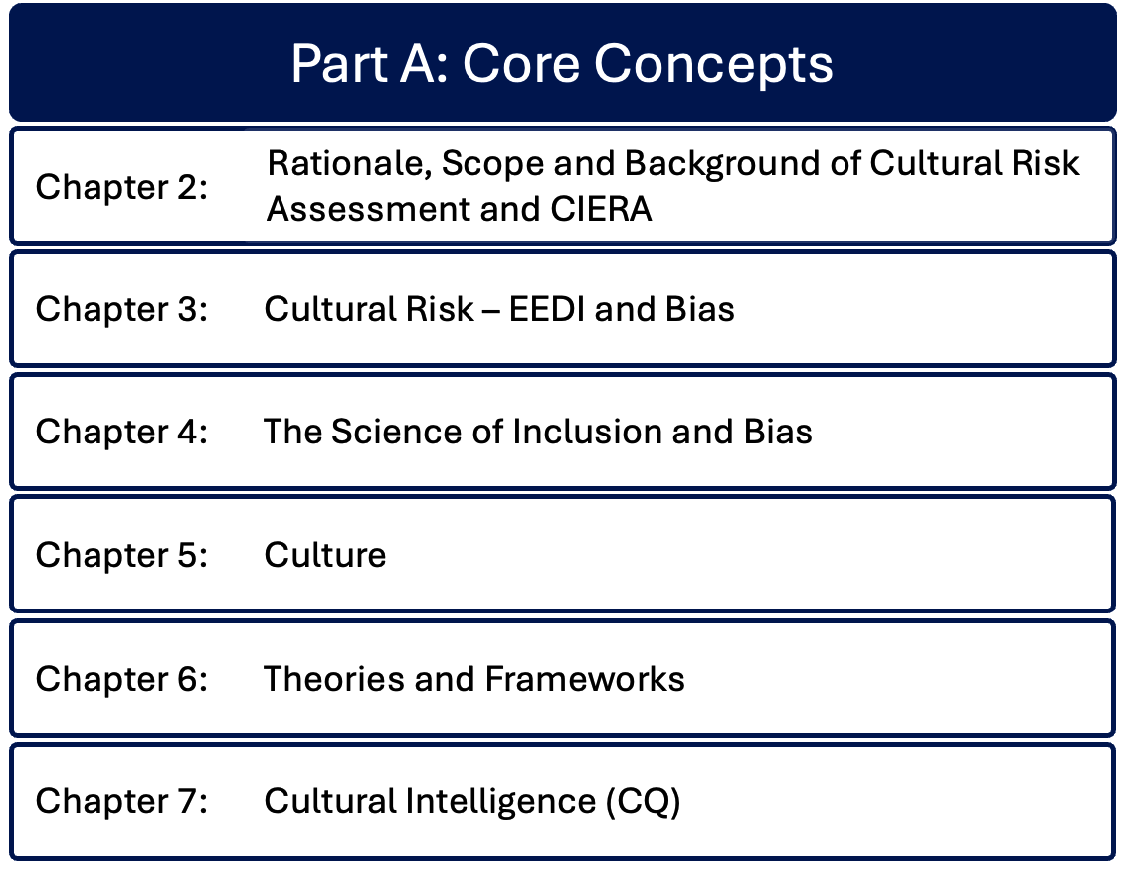

Slide 4
Chapter 7: Cultural Intelligence (CQ).
Bernadette Albert & Ruth Dowson
Conceptualises the various dimensions of Cultural Intelligence (CQ) and its significance in the event industry, through its cognitive, behavioural, motivational and metacognitive aspects.
Values awareness and adaptability in forming new cultural cognitive schemata, supporting cultural agility.
Promotes the importance of event organisations and their leadership transitioning away from ‘traditional’ hard skills towards cultural intelligence as the new ‘hard skill’.
Justifies why CQ is fundamental for event managers to excel in diverse globalised event environments and how its development feeds into EEDI strategy and systemic transformation, with tools and models presenting the Cultural Intelligence development framework.

Slide 5
Introduction – Cultural Intelligence (CQ)
EEDI, Inclusion, Culture and its theoretical foundations combine to justify the need for CQ
Event sector professionalisation requires industry-specific skills that include cultural competence
Early & Ang (2003) define CQ as “a person’s capability to adapt to new cultural contexts”
‘Cultural chameleons’ transition easily from one culture to another
Key elements: behaviour, cognition, meta cognition, motivation
Chapter applies Early & Ang from the individual to professional, corporate and social structures
Embed CQ as a core competency in event management

Slide 6
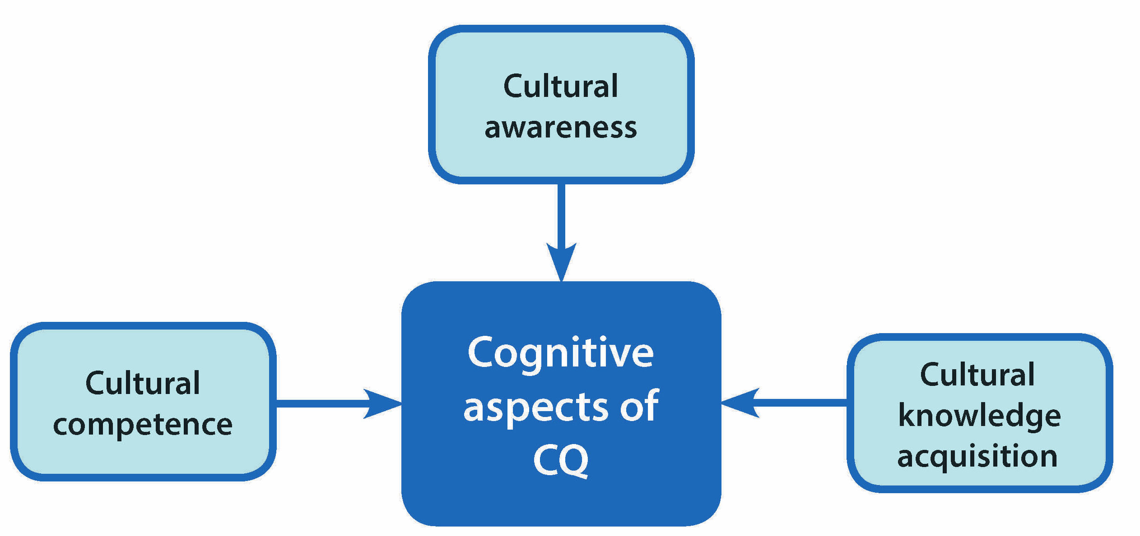
Cognitive aspects of Cultural Intelligence (CQ)

Slide 7
Cognitive aspects of Cultural Intelligence (CQ) – steps
Build individual knowledge and awareness of different cultures
Acquire cultural knowledge through academic learning, authentic sources including language and deeper cultural expressions, including participation in cultural evens, working with diaspora communities, observing adaptations in other social and geographic environments
Build cultural competence

Slide 8
Metacognitive aspects of CQ
Individual level of conscious cultural awareness, processed through cultural interactions
Awareness of influence of personal cultural schemata on interpretation of other cultures
Mental processes embedded in: self awareness; other awareness, situational awareness
Self awareness of conscious and unconscious bias; of personal cultural hierarchies
Reflect on personal values, norms, behaviours
Planning, preparation and checking prior to engagement in cross-cultural contexts

Slide 9
Motivation aspects of CQ
Experience of other cultures can extend beyond comfort zones, causing anxiety and uncertainty
Intrinsic / Extrinsic drivers
Cultural resilience within cross-cultural interface
Requires ability to focus attention and energy towards learning

Slide 10
Behavioural aspects of CQ
Ability to utilise cultural self-awareness, cultural humility, respect, flexibility, adaptation
Lifelong commitment to learning
Recognise value and equality across diversity
Recognise that dominant cultures may exhibit judgement or express cultural superiority
Openness to behavioural change, beyond rhetoric

Slide 11
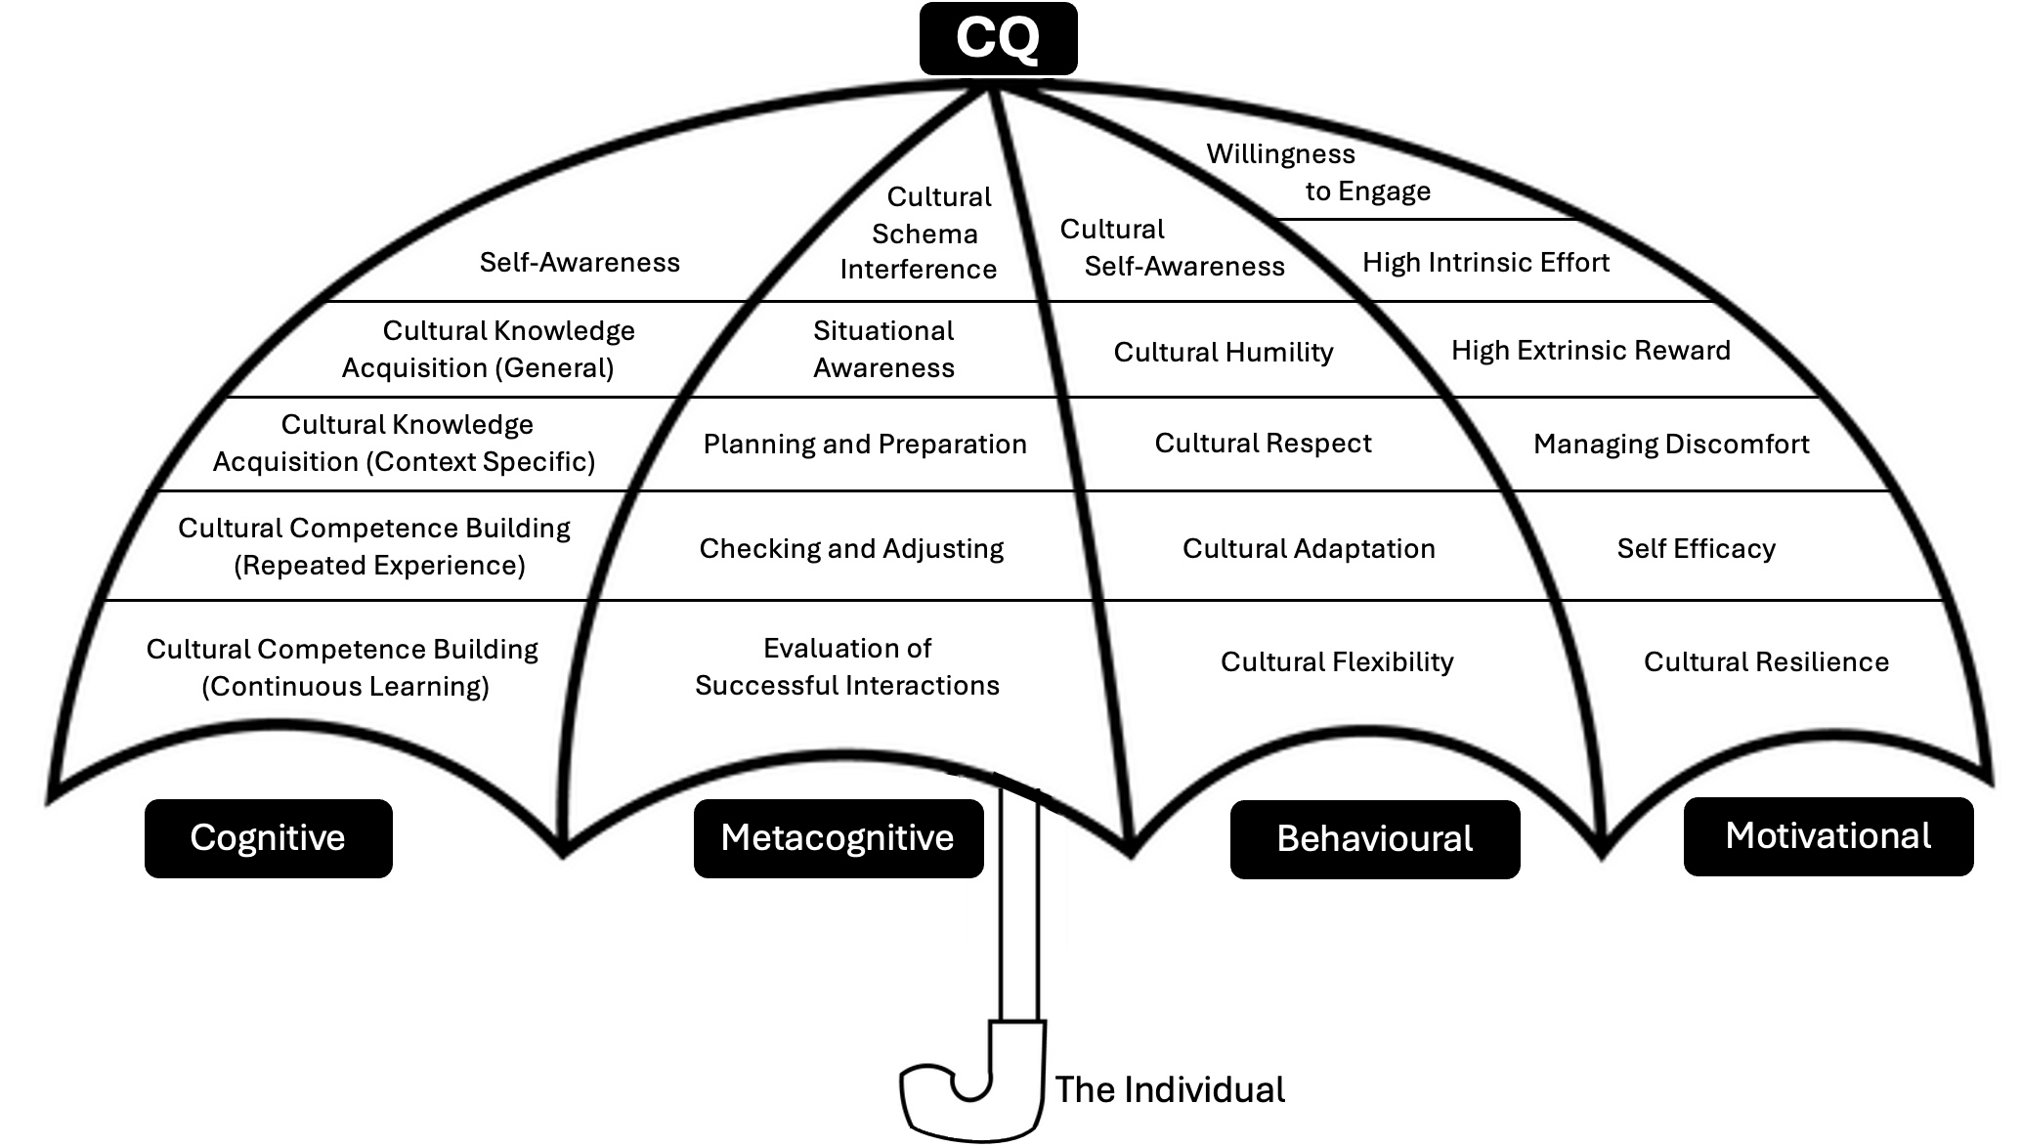
Connections between cognitive, metacognitive, behavioural and motivational elements of CQ

Slide 12
Cultural Intelligence and events
Despite perception of CQ as a ‘soft skill’, the process is arduous and discomforting
Globally-diverse and multiculturally complex nature of events requires strategic inclusion beyond EDI
CQ is becoming quantifiable, an asset to organisations operating in the global market
Developing CQ in event organisations – requires ability to navigate cultural complexities of internal and external stakeholders, managing cultural risk
Event leadership – as diversity grows, organisational leaders require broader and deeper cultural knowledge to mitigate potential risks
Cultural agility – needed within organisations and individuals to work across cultural boundaries

Slide 13
CQ and the event space
Physical environment, event atmosphere, logistical elements
The Cultural Risk Assessment (CRA) and CIERA (Cultural Inclusivity and Equity Risk Management) sensible the creation of culturally intelligent spaces
Event professionals require awareness of cultural requirements and risks

Slide 14
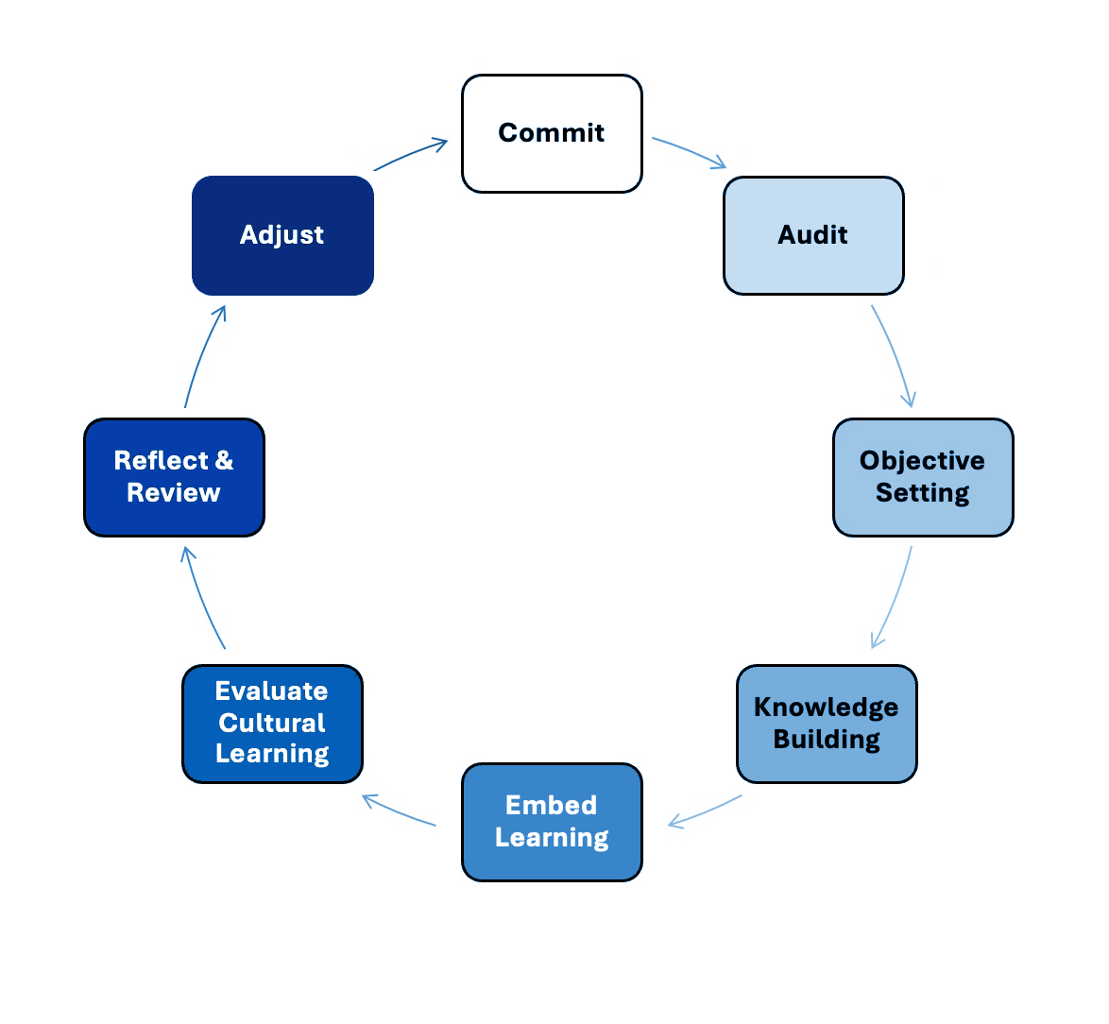
Developing Cultural Intelligence (CQ) – the Cultural Intelligence Learning Cycle – steps
Commit to the process
Personal cultural audit
Set objectives for development
Cultural knowledge building including CRA
Embed your learning
Evaluate cultural learning
Reflect and review
Adjust, reposition and note knowledge gaps
Back to step 1 to address gaps

Slide 15
Summary
Cultural Intelligence (CQ) is significant in the events industry through cognitive, behavioural, motivational and metacognitive aspects
Requires awareness and adaptability
Event leadership in CQ is a hard skill, fundamental to excellence

Slide 16
Discussion Questions
Based on what you have read in this chapter, list three things you could do in the next three months to assess your own cultural intelligence.
How can event managers develop their own cultural intelligence?
List three benefits to event organisations of taking the strategic approach to developing cultural intelligence proposed in this chapter.
What are the disadvantages of not developing cultural intelligence?
What challenges face organisations that choose to commit to developing the cultural intelligence of their staff?

